Slide 1
Equine Strangles by Assistant Professor Dr. Jihad A. Ahmed

Slide 2
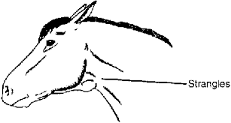
Strangles
Strangles is an infectious, contagious disease of Equidae characterized by abscessation of the lymphoid tissue of the upper respirstory Tract.
Word strangel derived from strangulation.

Slide 3
Etiology
Strangles caused by G +ive capsulated β- hemolytic Lancefield group C coccus, which is an obligate parasite and a primary pathogen.
Organism causes clinical disease in horses,mules and donkey.
Streptococcus equi produce high morbidity and low mortality in susceptible population.
Horses with less than 5 years of are more susceptible.

Slide 4
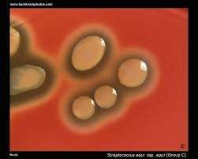

Slide 5
Transmission
Transmission occurs via fomites and direct contact with infectious exudates. Carrier animals are important for maintenance of the bacteria between epizootics and initiation of outbreaks on premises previously free of disease.
This organism produce typicaly honey dew like colonies which are hemolytic on blood agar.
This organism spread from one animal to other by respiratory tract secretions.

Slide 6
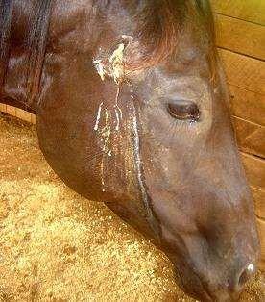

Slide 8
Clinical signs
Incubation period upto 10 days.
Acute febrile reaction observe in unexperienced horses.
Residual immunity prevent acute febrile condition.
Swelling of sub-mandibular and reteropharyngeal lymph node.
Animal show dysphagia, respiratory sturtle and respiratory distress.

Slide 9
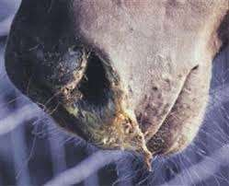

Slide 10
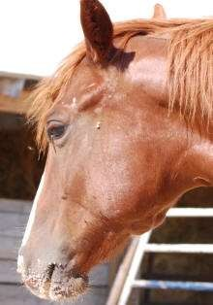

Slide 11
Clinical signs
In untreated animals the disease progress from pharangeal lymph node to guttral pouch and start abcessation in guttral pouch.
Infection metastatize to other organs leads to the development of bastard strangle.
Purpura hemorrhagica seen on head and neck area.
In latter stages discharge becomes muccopurrulent.

Slide 12
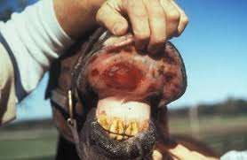

Slide 13
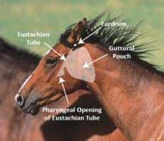

Slide 15
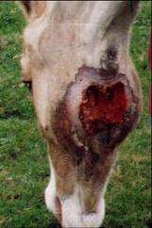

Slide 16
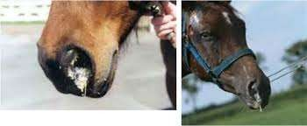
Diagnosis:
Disease observe in horses with less than 5 yr of age.
In chronic case organism invade guttral pouch and become chronic shedder.
Stone like bodies in guttral pouch known as chondroid bodies.
Dx based on clinical signs.

Slide 17
Complications
Most recover without complications .
Infection metastatize to other body parts ( Bastard strangle).
Strangulation of airway.
Purpura hemorrhagica.
Muscle disease.
Decrease milk production in mare.
Guttral pouch emphysema .
Laryngeal paralysis.

Slide 18
Treatment
80 lakh pencillin
Doxycycline
Potassium iodide
BID
BID 10mg/kg

